Slide 1
Exploratory Data Analysis on the Billionaire Dataset
IBU 512 Advanced Topics in Database Systems
Ajla Korman

Slide 2
Introduction
Billionaire wealth is not distributed equally across the world
This research looks at:
who billionaires are
where they come from
which industry they operate in
age and gender demographics
Aim of the research was:
Find out what factors influence billionaire growth
Helps understand why some places have more billionaires than others

Slide 3
Methods & Material
Billionaire Statistics Dataset
Contains 35 attributes on billionaires worldwide
Includes information on net worth, industries, age and gender, country of citizenship, and economic indicators
Used for EDA (Exploratory Data Analysis)
Python libraries used: Pandas, NumPy, Matplotlib, and Seaborn for data analysis and visualization

Slide 4
Data Preprocessing & Cleaning
Removed unnecessary columns (e.g., birth details, specific locations, first and last name)
Handled missing values: Used OpenAI API & World Bank API for estimation
Dropped null & duplicate records to improve dataset quality
Final dataset contained 15 key columns and 2457 records
rank | personName | finalWorth | age | gender
industries | countryOfCitizenship | selfMade | gdp_country | tax_revenue_country
total_tax_rate_country | population_country | source | organization | city

Slide 5
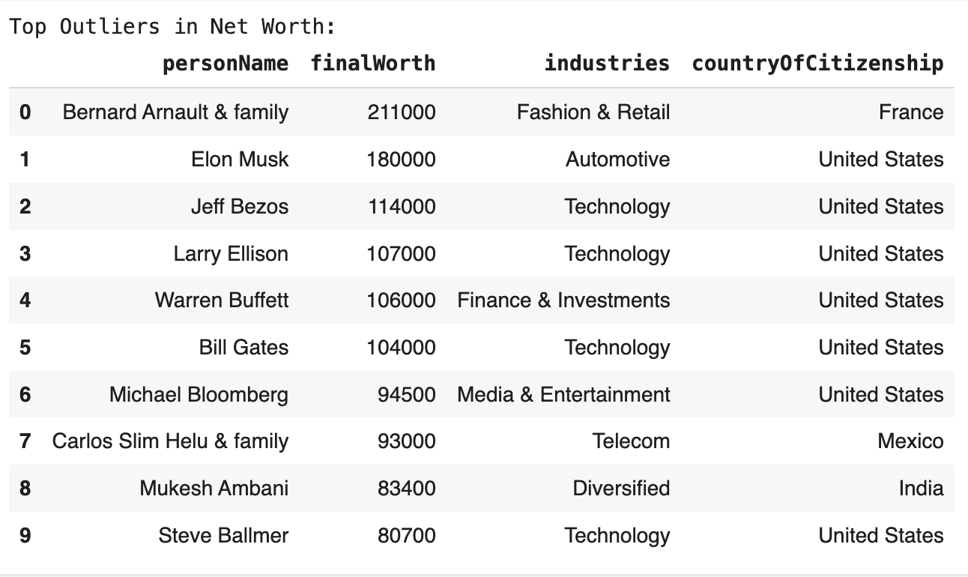
Net Worth Analysis
Calculated key statistics: Mean, median, and outliers using IQR method.
Plotted histogram: Showed billionaire net worth distribution.
Identified industries with highest net worth: Tech, Finance, Manufacturing.

Slide 6
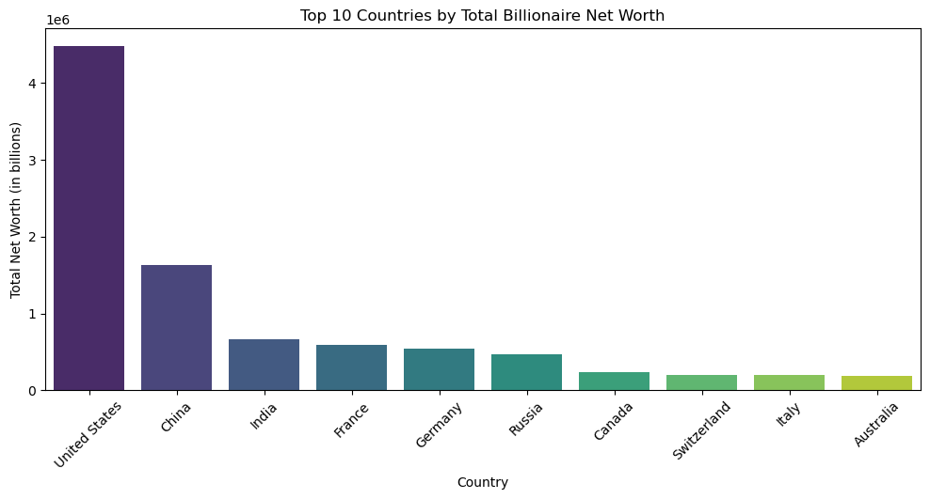
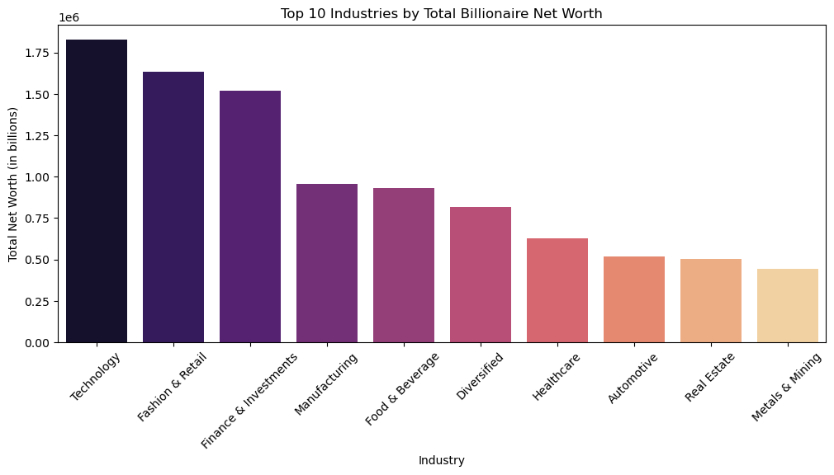
Net Worth Analysis
The United States has the highest total billionaire net worth
Technology, Finance & Retail are the most profitable industries for billionaires
Wealth concentration is highly uneven, with a few countries and industries dominating

Slide 7
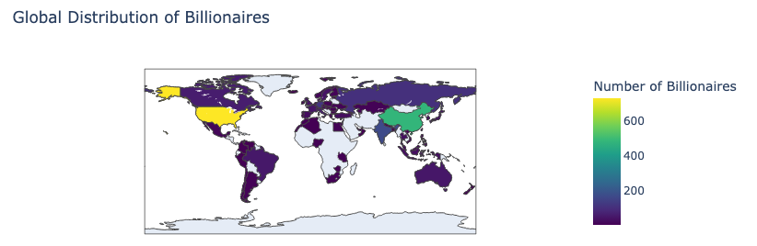
Geographical Distribution
Mapped billionaires per country using a choropleth map
Shows unequal distribution in the whole world

Slide 8
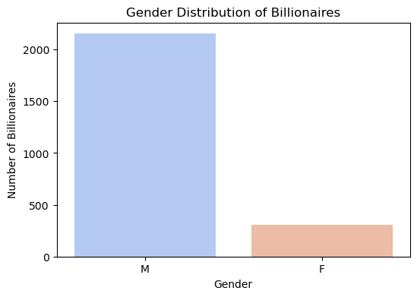
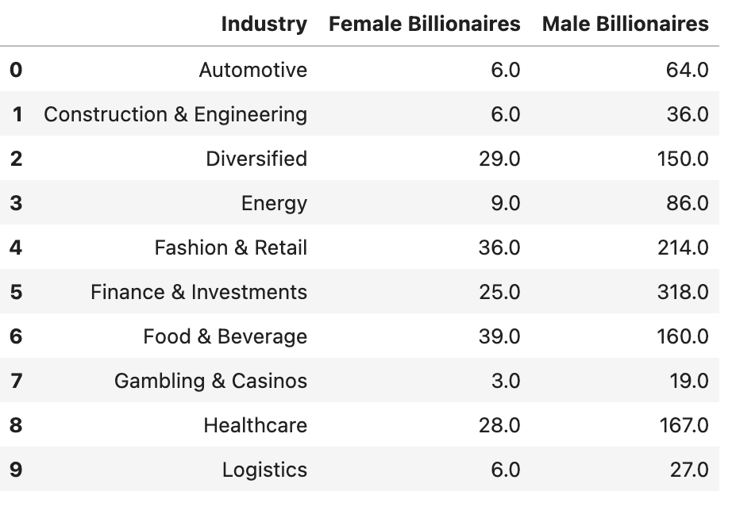
Gender Analysis
Significant gender gap: Male billionaires greatly outnumber female billionaires
Industries with higher female representation: Fashion, Retail, Food & Beverage
Socioeconomic & historical barriers limited female wealth accumulation

Slide 9
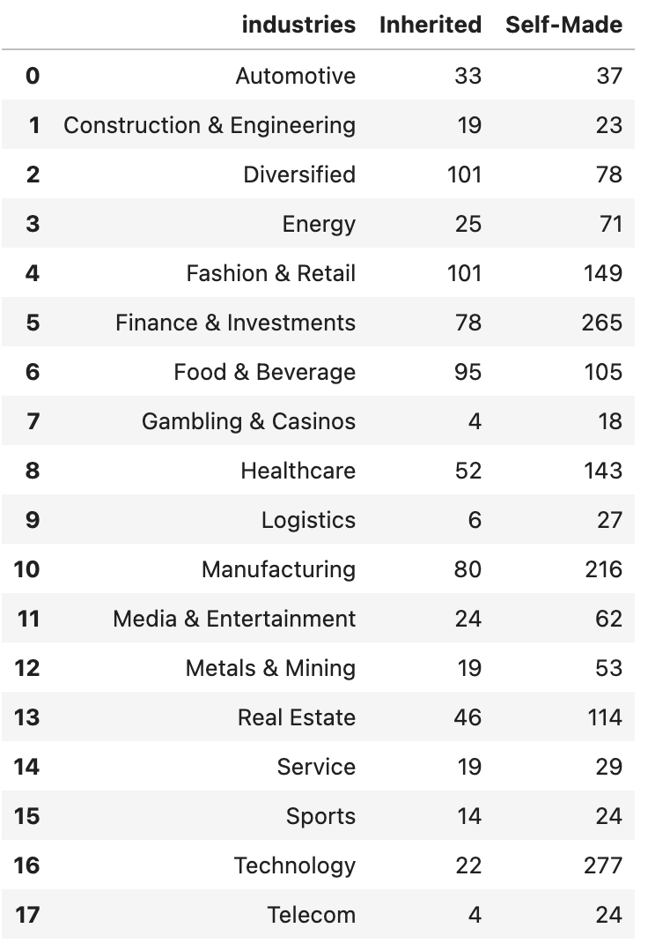
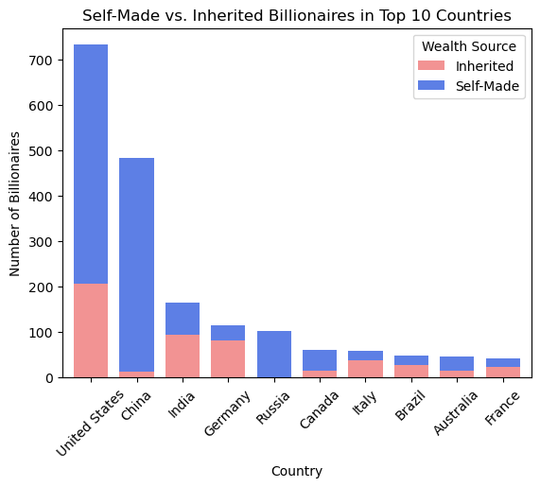
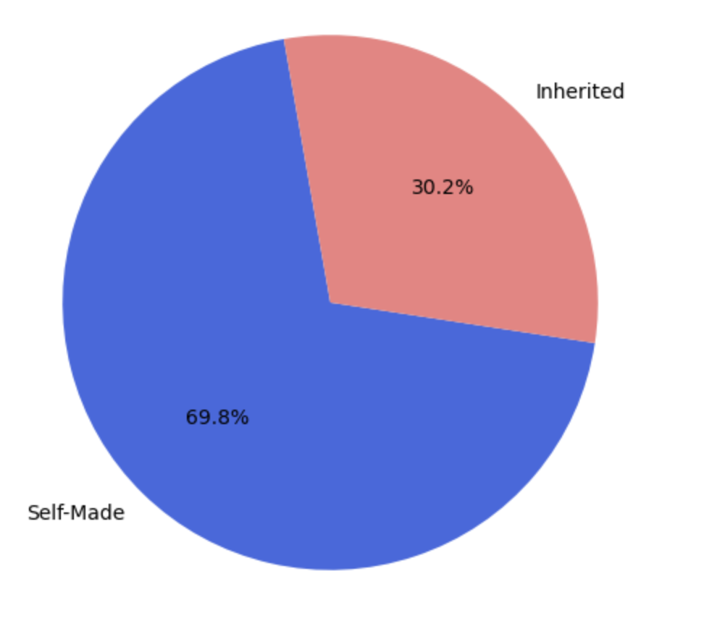
Wealth Source Analysis
Most billionaires are self-made (69.8%)
Industries with highest self-made billionaires: Tech, Manufacturing, Finance
Regional differences: U.S. has highest share of self-made billionaires

Slide 10
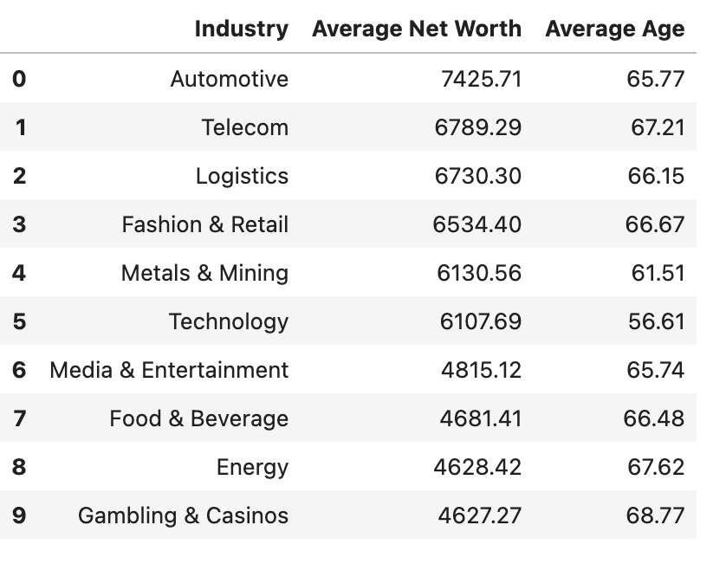
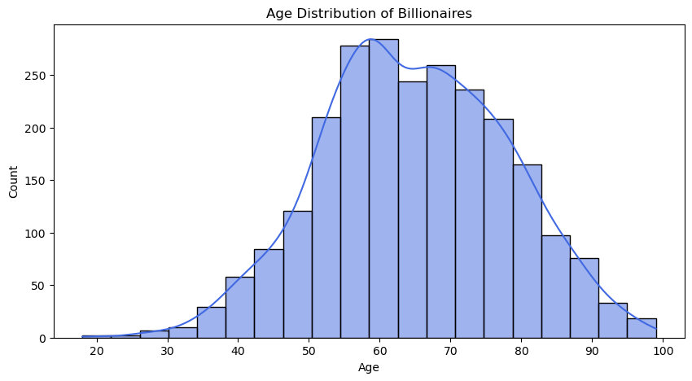
Age Distribution
Histogram of billionaire ages: Most are between 50-70 years old
Younger billionaires dominate Tech industry, while older ones are in Manufacturing & Energy

Slide 11
Key Findings & Discussion
Wealth is Highly Concentrated in a Few Countries:
The United States dominates in total billionaire net worth, followed by China and India. European and emerging economies contribute at lower levels.
Technology, Finance, and Retail Drive Billionaire Wealth:
The technology sector, in particular, has created more self-made billionaires, unlike inherited wealth in industries such as real estate or manufacturing.

Slide 12
Key Findings & Discussion
Persistent Gender Disparity in Billionaire Distribution:
The number of male billionaires vastly outnumbers female billionaires.
Female billionaires are concentrated in industries like Fashion & Retail and Food & Beverage, often linked to inherited wealth.
Self-Made Billionaires are the Majority:
Most billionaires accumulate wealth through entrepreneurship, rather than inheritance.
This is especially evident in sectors like Technology and Finance, where innovation plays a crucial role.

Slide 13
Conclusion & Future Work
Research confirmed global wealth concentration patterns.
Findings align with past studies on billionaire demographics & economics.
Future work:
Time-series analysis of billionaire growth over decades.
Machine learning models for billionaire wealth prediction.

Slide 14
Thank you for your attention

